Slide 2
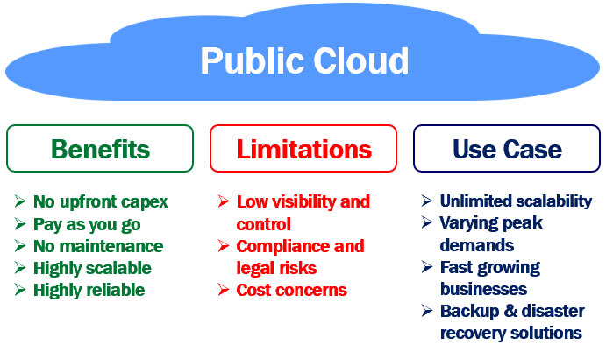

Slide 3
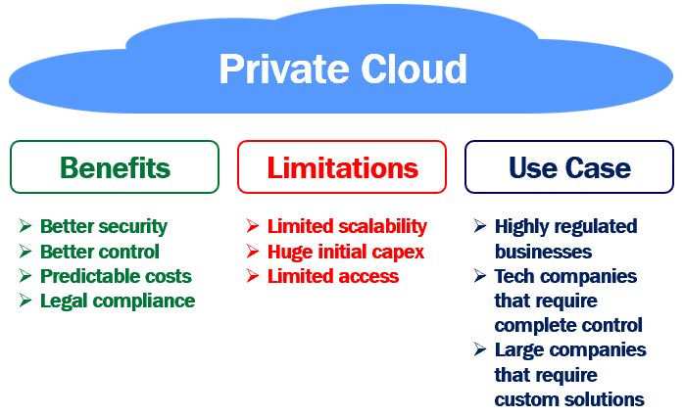

Slide 4
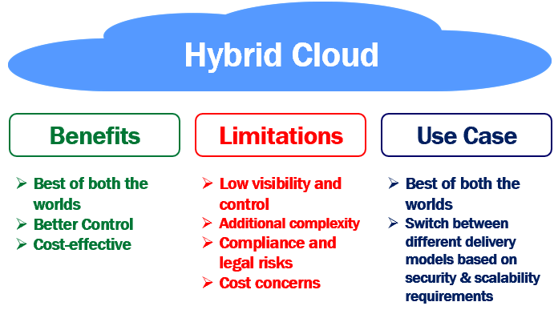

Slide 5
 | Private Cloud | Public Cloud | Hybrid Cloud
Cloud Hardware | The entire cloud infrastructure (i.e the physical servers, storage, networking etc) must be procured by the organisation that owns the private cloud | The public cloud service provider like Amazon or Microsoft provides the infrastructure | For the private cloud, your organisation must provide the infrastructure where as the public cloud service provider provides the infrastructure for the public cloud
Tenancy | Single-tenancy. A private cloud is usually used by a single organisation. | Multi-tenancy: A public cloud is used by multiple organizations. | The private part of the hybrid cloud is used by a single organisation. The public part of the hybrid cloud is used by multiple organisations.

Slide 6
Data Center Location | Inside the organization’s corporate network. | Anywhere on the Internet. Public cloud (like AWS and Azure) data centers for example, are typically located in many countries across the entire world. | The private cloud data center is typically inside the organisation's corporate network and the public cloud data center could be anywhere on the internet.
Scalability | Private cloud scalability is limited by the amount of infrastructure. Beyond certain point it is impossible to scale up, unless the organisation procures additional hardware and set it up. | We never run out of resources in a public cloud. It provides near-unlimited scalability. | The scalability of the private cloud services and resources is limited by the underlying available infrastructure, where as with the public cloud services we do not have such a limitation.

Slide 7
Cloud Maintenance | The organization itself is responsible for setting up and maintaining the private cloud. | The cloud service provider is responsible for setting up and maintaining the public cloud. Organizations and even general public can use the public cloud services by paying a monthly fee. | The private cloud is managed by the organization that owns it where as the public cloud is managed by the cloud service provider.
Costs | Invloves huge initial capital expenditure as the organization must purchase all the cloud hardware, set it up and maintain there on. To maintain the private cloud, the organization needs to hire work force. So there is monthly operating expenditure as well. | With the public cloud there is no initial capital expenditure, but you pay a monthly fee for the public cloud services you use. The more you use the services, the more you have to pay. The overall price tag may be higher than what you anticipated, especially if you use lot of public cloud services for a long time. | With the private cloud, the organization is faced with both, the intital capital expenditure as well as monthly operating expenses to maintain it. With the public cloud you pay a monthly fee for the services and resources you use.

Slide 8
Accessibility | Only the organization that owns the private cloud can access private cloud resources and services. | A public cloud is exposed to the public. So, anyone can access it's resources and services. | Private cloud services can be accessed only by the organization that owns it where as public cloud services can be accessed by anyone.

Slide 9
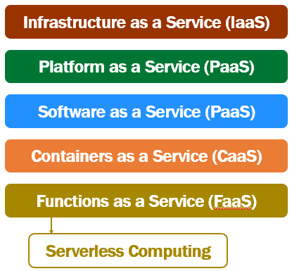

Slide 10
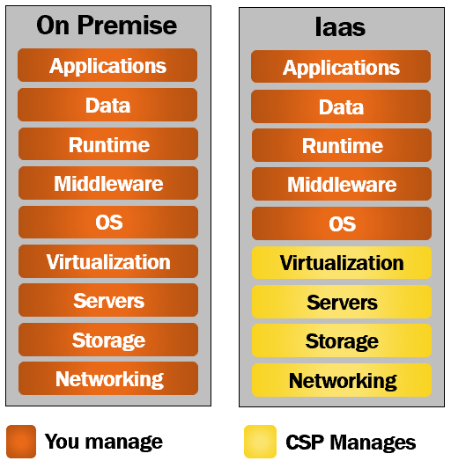

Slide 11
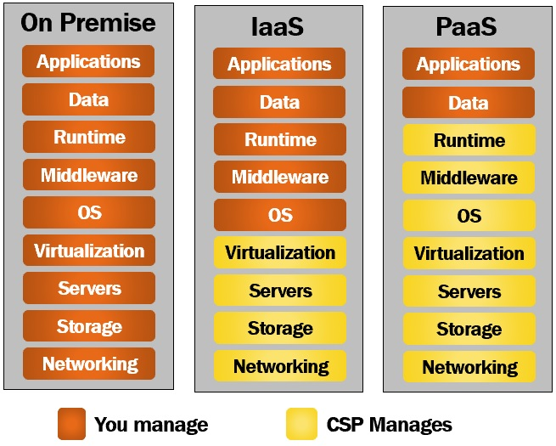

Slide 12
